Slide 1
General knowledge quiz
By Annie Stephens

Slide 2
What is the capital of Wales?
a)Spain
b)London
c)Cardiff

Slide 3
correct!

Slide 4
wronggggg of course

Slide 5
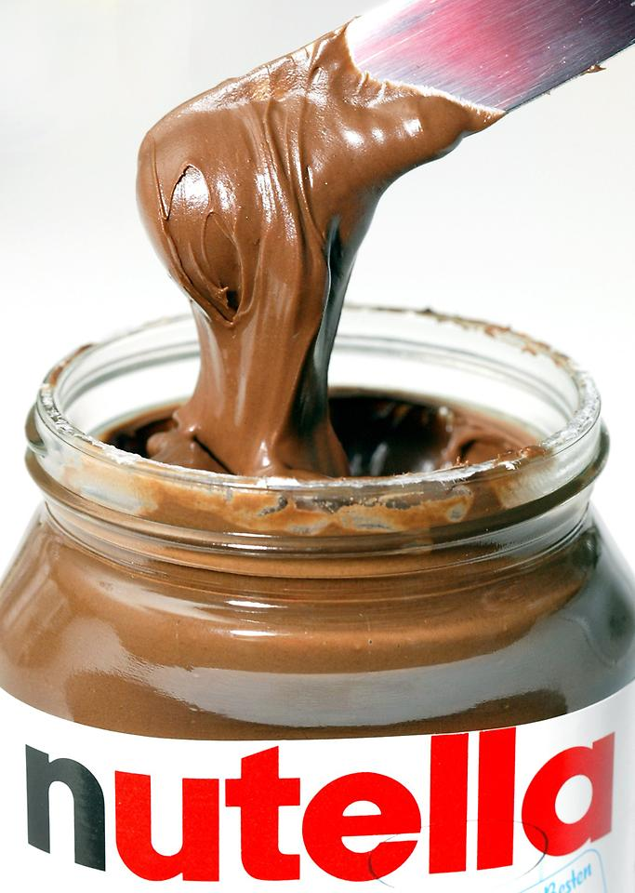
When did the creator of Nutella die?
a) January 2014
b) February 2015
c) October 1994

Slide 6
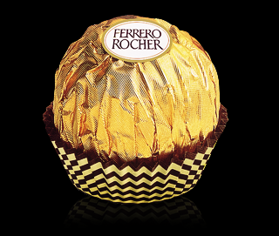
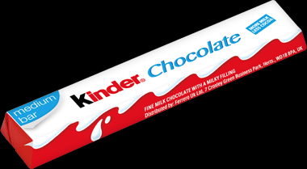
WELL DONE you know your stuff!

Slide 7
Noooo why would you make this mistake???

Slide 8
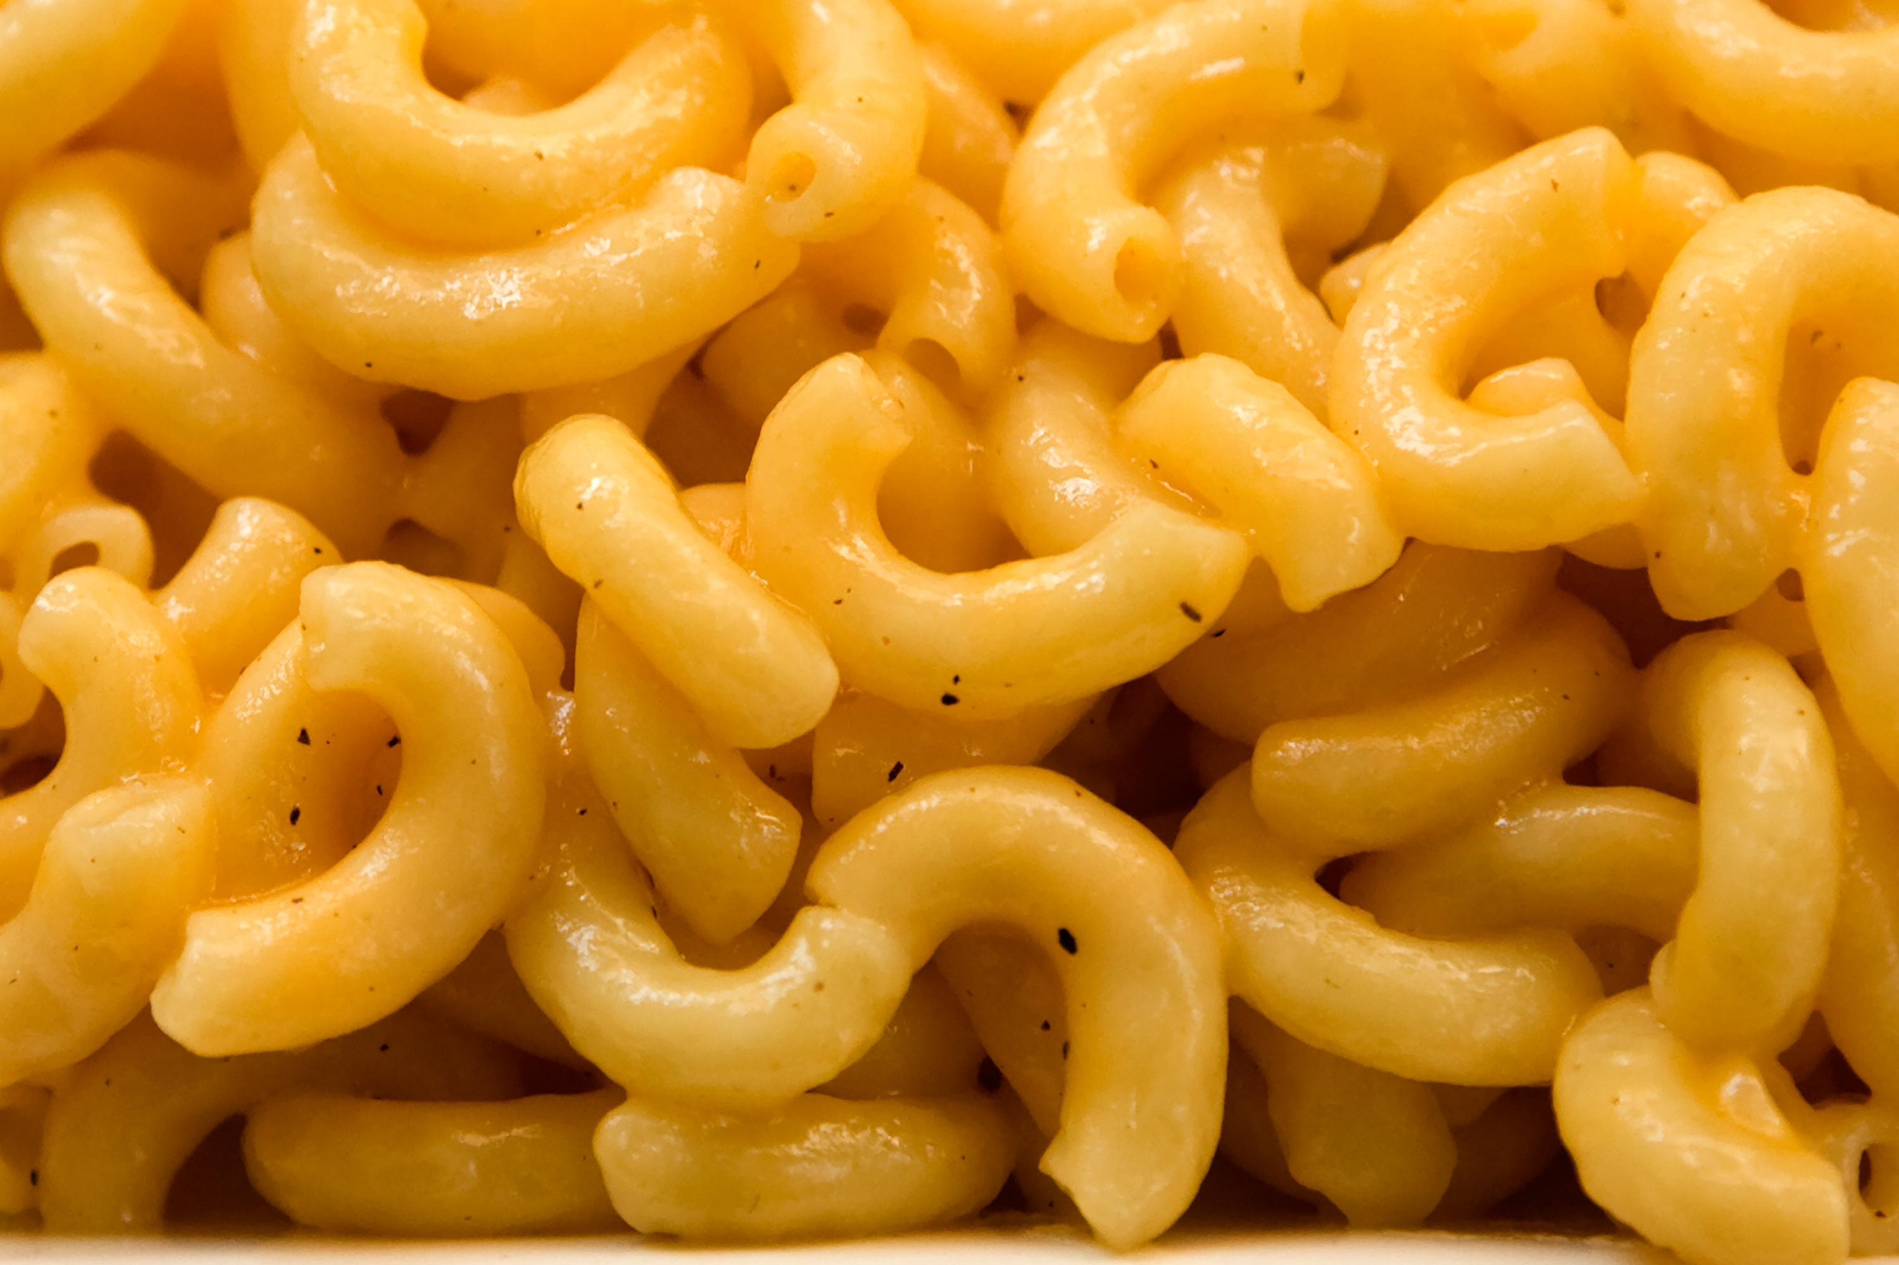
Who introduced macaroni to the US?
A) Abraham Lincoln
B) Neil Armstrong
C) Thomas Jefferson
D) Jamie Oliver

Slide 9
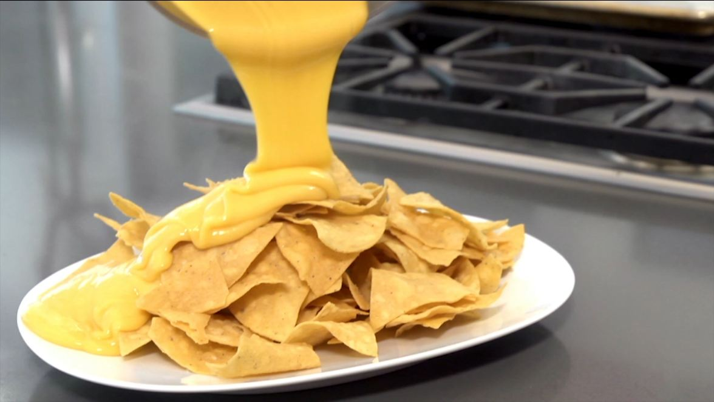
yay well done!

Slide 10
nooooooo!

Slide 11
well done you’ve finished

